Slide 1

Amazon Sales Analysis 2010-2017

Slide 2
Introduction to Amazon:
The world's largest online retailer and cloud services provider.
Founded by Jeff Bezos as Cadabra Inc. in 1994.
Launched Amazon.com in 1995, initially as an online bookstore.
Rapid expansion into other product categories such as electronics, apparel, and more.

Slide 3
Project analysis slide 2
Sales Performance
The country with the highest sales volume is Australia and Oceania, specifically Tuvalu. Their sales transaction for Baby Food resulted in 9,925 units sold with a total revenue of $2,533,654 and a total profit of $951,410.50.
The country with the lowest sales volume is Sub-Saharan Africa, specifically Sao Tome and Principe. Their sales transaction for Fruits resulted in 8,102 units sold with a total revenue of $75,591.66 and a total profit of $19,525.82.
Offline Sales:
Total Units Sold: 2,76,782
Total Revenue: 7,90,94,809.2
Total Profit: 2,49,20,726.67
Online Sales:
Total Units Sold: 2,36,089
Total Revenue: 5,82,53,959.11
Total Profit: 1,92,47,471.73

Slide 4
Project analysis slide 3
Sales Performance
The Highest Sales volume in Item is Cosmetics, 83,718 units sold with the Revenue of 3,66,01,509.6 and Profit of 1,45,56,048.66.
The Lowest Sales volume is Meat with 10,675.
Lowest Revenue and Profit is Fruits with 4,66,481.34 & 1,20,495.18

Slide 5
Project analysis slide 4
KPIs
REVENUE
13,73,48,768.3
PROFIT
4,41,68,198.4
COST
9,31,80,569.91
TOTAL ORDERS
100
TOTAL UNITS
5,12,871
Sales occurred both online and offline.
Orders had different priorities and were placed on specific dates, and each order had a unique ID.
The number of units sold varied for each item.
The unit price and cost influenced the total revenue and profit.

Slide 6
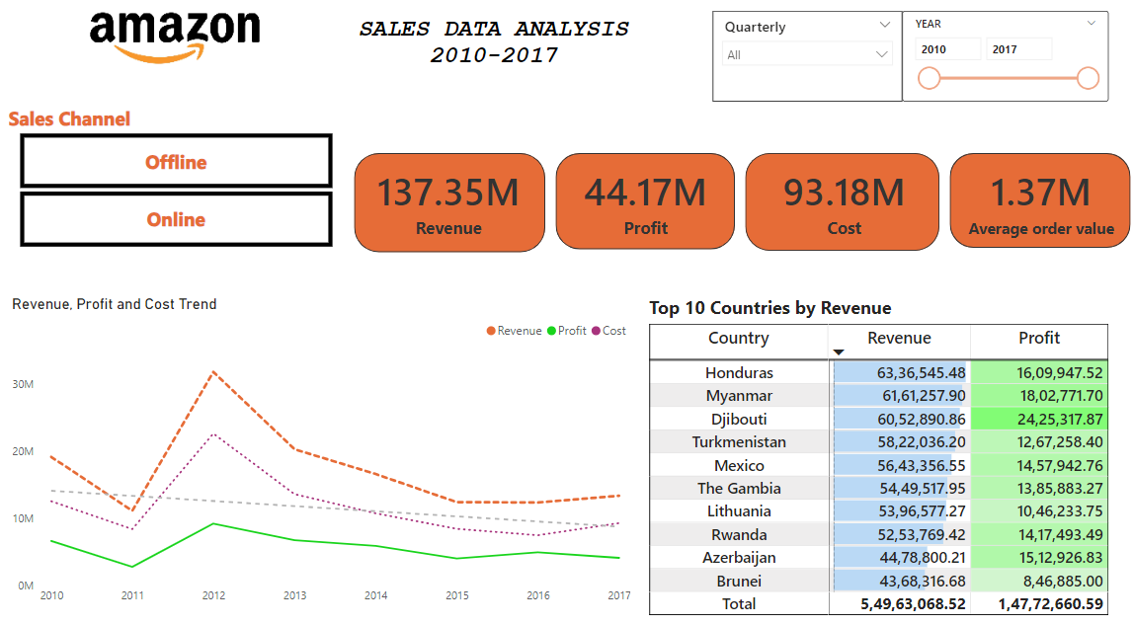
Project analysis slide 5
INSIGHTS

Slide 7
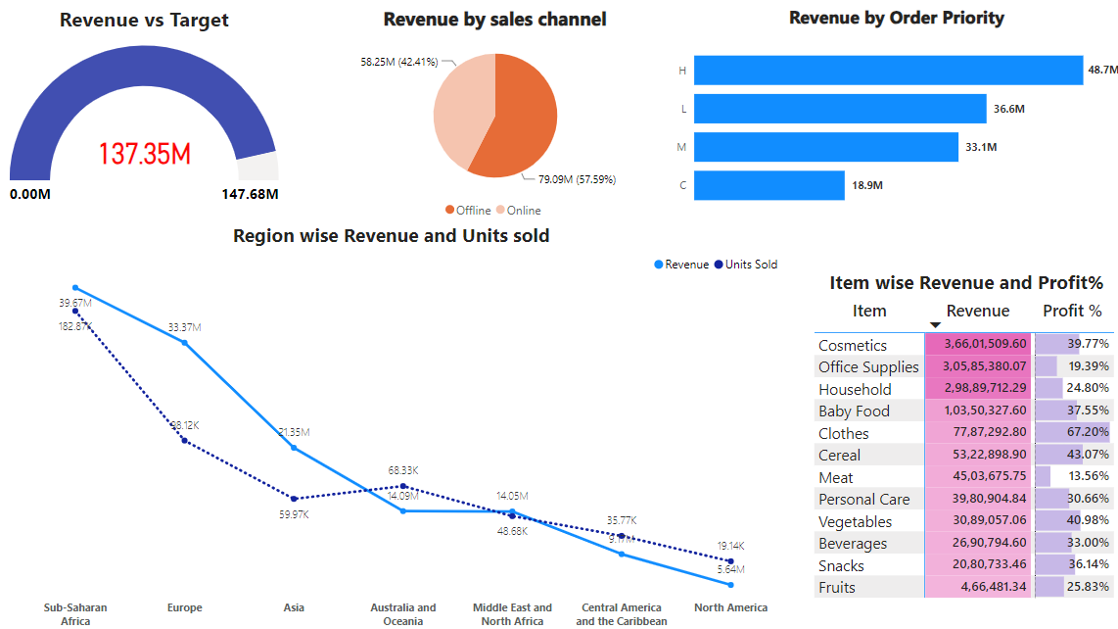
Project analysis slide 6
Revenue Analysis

Slide 8
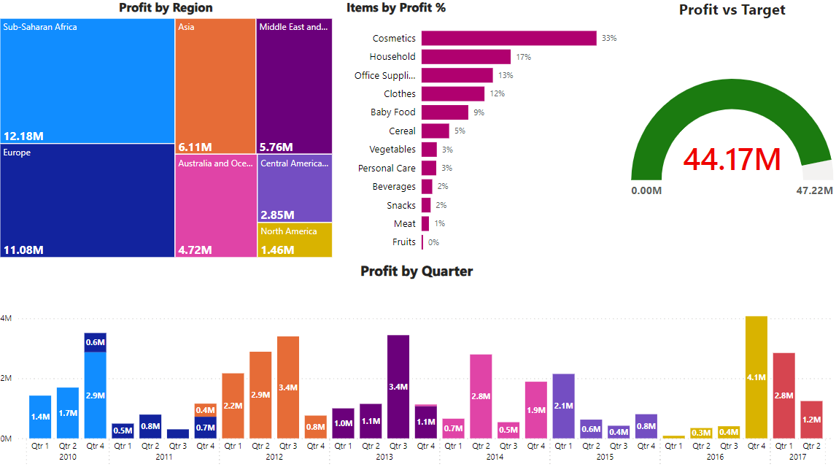
Project analysis slide 7
Profit Analysis

Slide 9
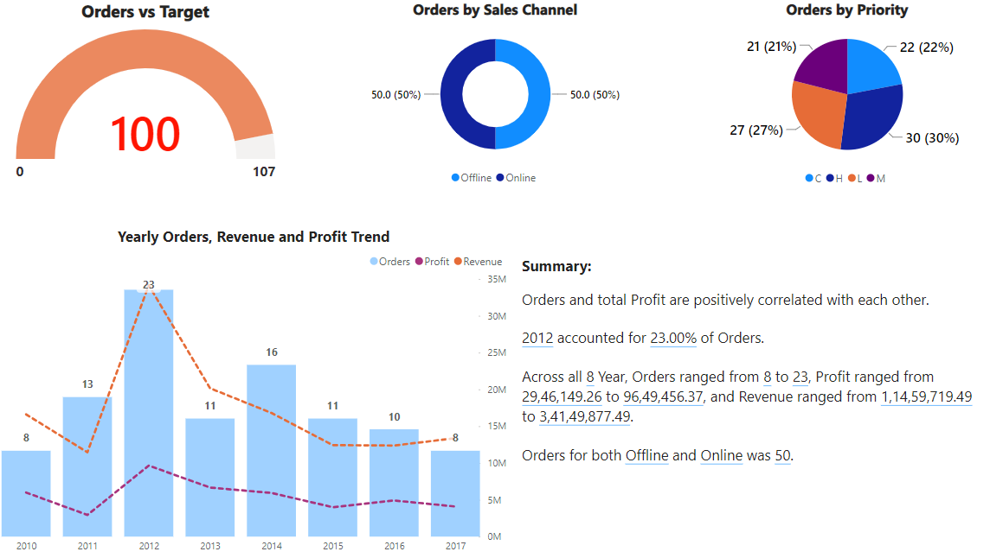
Project analysis slide 8
Orders Analysis

Slide 10
Thank You

